Slide 1
Introduction to R
Alexis Blanchet-Cohen
Bioinformatics analyst, IRCM

Slide 2
Ressources
R-3.0.2: http://probability.ca/cran/
Rstudio: http://www.rstudio.com/ide/download/
Official R tutorial: http://cran.r-project.org/doc/manuals/R-intro.html
R Cookbook, by Paul Teetor.

Slide 3
Hello World!
> "Hello World!"
> msg <- "Hello World!"
> print(msg)
> msg

Slide 4
Assignment operator in R '<-'
x <- c(1, 2, 3, 4)
'<-' vs '='
Do not use the '=' operator as an assignment operator. This is simply a convention. The behavior of '<-' and '=' as assignment operators are identical.
Notes:
http://csgillespie.wordpress.com/2010/11/16/assignment-operators-in-r-vs/

Slide 5
Help function
> help('<-')
> ?('<-')
> ?t.test

Slide 6
Vectors in R
> x <- c(1,2,3,4)
> y <- c("a", "b", "c", "d")
> z <- c("TRUE", "FALSE", "TRUE")
Other types of objects:
Lists (like vectors but can be heterogeneous)
Matrices (Vectors with dimensions)
Data frames (List of vectors, like a spreadsheet in Excel)

Slide 7
Dataframes
> x <- c(1,2)
> y <- c("a","b")
> dd <- data.frame(x,y)
> htseqcount <- read.table("htseqcount/counts_D17p7_A3_cyto.txt")

Slide 8
lapply
Apply a function over a list-like or vector-like object
> x <- 1:10
> lapply(x, sqrt)

Slide 9
Other control functions
> if(1=="2") {} else {}
> for(i in length(x)) {}
Note that for loops are rarely used in R. lapply is far more commonly used.

Slide 10
Libraries
CRAN (Comprehensive R Archive Network)
> install.packages("plotrix")
Bioconductor
> source(“http://www.bioconductor.org/biocLite.R”)
> biocLite("DESeq2")
> vignette("DESeq2")
> biocLite("iBMQ")

Slide 11
User-defined functions
> hello <- function() {print ("Hello World")}
smile.R
> x <- 1:10
> y <- 11:20
> smile(x,y)
> smile(x,y,emotion="grumpy")

Slide 12
Statistics
x <- rnorm(1000)
y <- rbinom(1000)
sum(x), var(x), cov(x)
t.test(x,y)

Slide 13
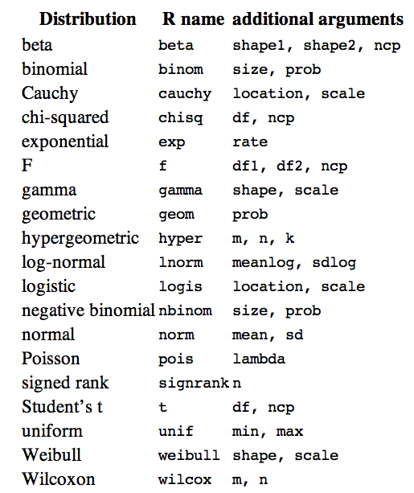
Distributions in R

Slide 14
Graphics in R
Plotting commands are divided into three basic groups:
High-level plotting functions create a new plot on the graphics device, possibly with axes, labels, titles and so on.
Low-level plotting functions add more information to an existing plot, such as extra points, lines and labels.
Interactive graphics functions allow you interactively add information to, or extract information from, an existing plot, using a pointing device such as a mouse.
(Source: http://cran.r-project.org/doc/manuals/R-intro.html#Graphics)

Slide 15
Graph example (Source: http://www.r-bloggers.com/creating-shaded-areas-in-r/)
> curve(dnorm(x,0,1),xlim=c(-3,3),main='Normal Density')
> cord.x <- c(-3)
> cord.y <- c(0)
> cord.x <- c(cord.x,-3)
> cord.y <- c(cord.y,dnorm(-3))
> cord.x <- c(cord.x,-2,-2)
> cord.y <- c(cord.y,dnorm(-2),0)
> polygon(cord.x,cord.y,col='skyblue')
# Second attempt
> cord.x <- c(-3,seq(-3,-2,0.01),-2)
> cord.y <- c(0,dnorm(seq(-3,-2,0.01)),0)
> curve(dnorm(x,0,1),xlim=c(-3,3),main='Standard Normal')
> polygon(cord.x,cord.y,col='skyblue')

Slide 16
High level plotting functions
plot
curve
boxplot
pie
hist

Slide 17
?par
par can be used to set or query graphical parameters. Parameters can be set by specifying them as arguments to par in tag = value form, or by passing them as a list of tagged values.
E.g.
> par(bg="red")

Slide 18
Example of graphs made from Homer data
Example: generateGraphs.R

Slide 19
Clustering
> # Sample clustering
> # A heatmap of this distance matrix gives us an overview over similarities and dissimilarities between samples
> pdf("../../deseq/plots/sample_clustering_all_genes.pdf")
> distsRL <- dist(t(counts(dds,normalized=TRUE)))
> mat <- as.matrix(distsRL)
> rownames(mat) <- colnames(mat) <- colnames(normalized.counts)
> heatmap.2(mat, trace="none", col = rev(hmcol), margin=c(13, 13))
> dev.off()

Slide 20
Heatmaps
> ?heatmap
> install.packages(gplots)
> library(gplots)
> ?heatmap.2

Slide 21
biomaRt
> library("biomaRt")
> ensembl = useMart(biomart="ENSEMBL_MART_ENSEMBL", dataset = "hsapiens_gene_ensembl", host="ensembl.org")
> gene.biotypes=getBM(attributes=c('ensembl_gene_id', 'external_gene_id', 'gene_biotype'), mart=ensembl)
> write.table(gene.biotypes, "annotation.txt", sep="\t", row.names=FALSE, quote=TRUE)

Slide 22
DESeq2 / DEXSeq
DESeq.R

Slide 23
cummeRbund
http://compbio.mit.edu/cummeRbund/manual_2_0.htm

